Slide 1
Six Step Instructional Approach for Responding to Challenging Behavior
Allison M. Bernard, M. Ed.
Elise Sarasin, MSE
Kathleen Lynne Lane, Ph. D., BCBA-D, CF-L2
University of Kansas
Institute of Education Sciences, U.S. Department of Education
R324N190002 University of Kansas
Notes:
As participants enter- encourage first-time module users to complete the sign in process (this ensures they can access modules later in the presentation)

Slide 2

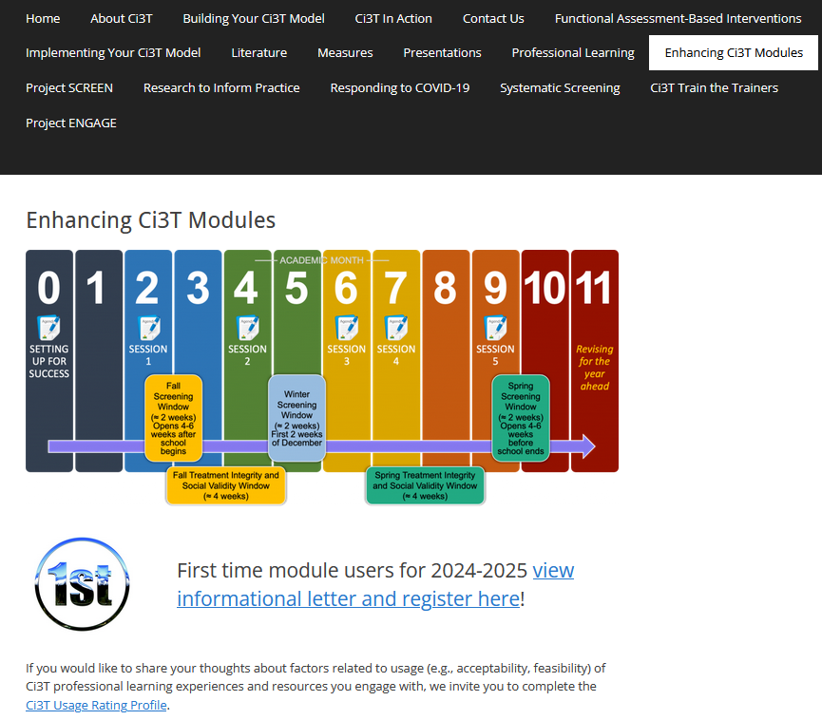

Enhancing Ci3T Modules
ci3t.org/enhance

Slide 3
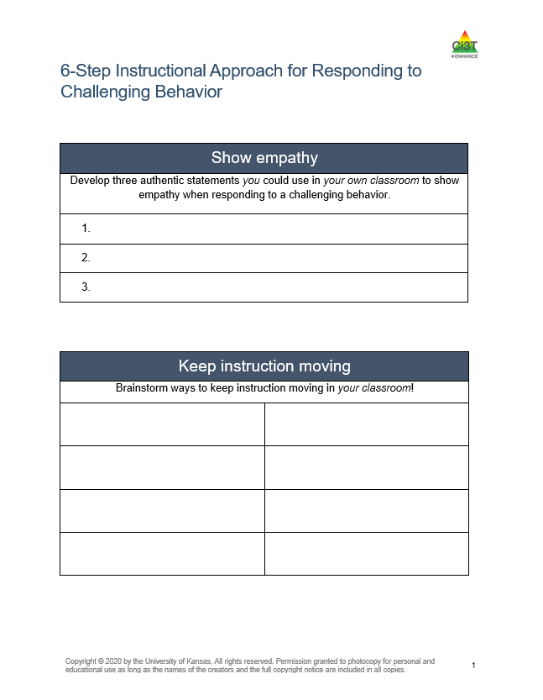
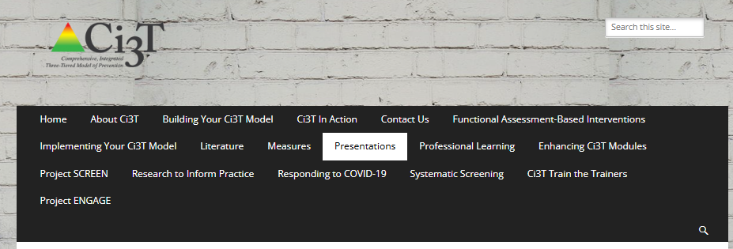
Access Today’s Materials
www.ci3t.org/presentations
Notes:
5-min timer

Slide 4
Agenda
Welcome
Overview of Tier 1
Describing a 6-step Instructional Approach for Responding to Challenging Behavior
Connecting Students to More Intensive Interventions
Wrapping Up and Moving Forward

Slide 5


Learning Objectives
Describe a 6-step instructional approach for responding to challenging behaviors
Identify what to do (examples), why to do it (behavioral principles for shaping behavior) and what not to do (non-examples) for each step
Describe potential Tier 2 and Tier 3 interventions for students needing more than Tier 1 practices.

Slide 6
Comprehensive, Integrated, Three-Tiered Model of Prevention
(Lane, Kalberg, & Menzies, 2009)
Tier 3
Tertiary Prevention (≈5%)
Tier 2
Secondary Prevention (≈15%)
Here is where we are starting today!
Tier 1
Primary Prevention (≈80%)
Academic ◇ Behavioral ◇ Social
Validated Curricula PBIS Framework Validated Curricula

Slide 7
Enhancing Ci3T Modules
ci3t.org/enhance

Slide 8
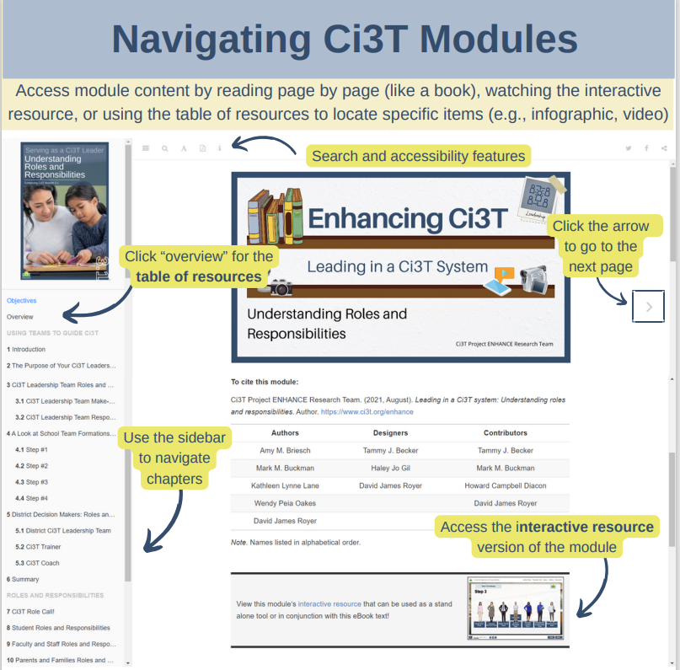

Slide 9


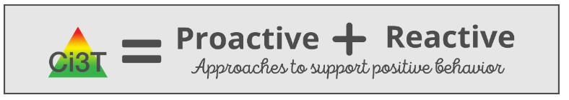

Tier 1: Support for All
Notes:
From module:
Each Ci3T Implementation Manual features proactive and reactive components to set the stage for positive, productive environments and enable faculty and staff be prepared to respond effectively when challenges arise.
Reactive approaches are instructional and respectful, providing an opportunity to empower teachers with the specific tools to navigate day-to-day challenges and model for students how to handle conflict.
Ci3T models prioritize building healthy teacher-student relationships.

Slide 10
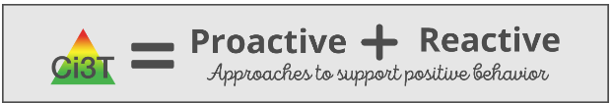
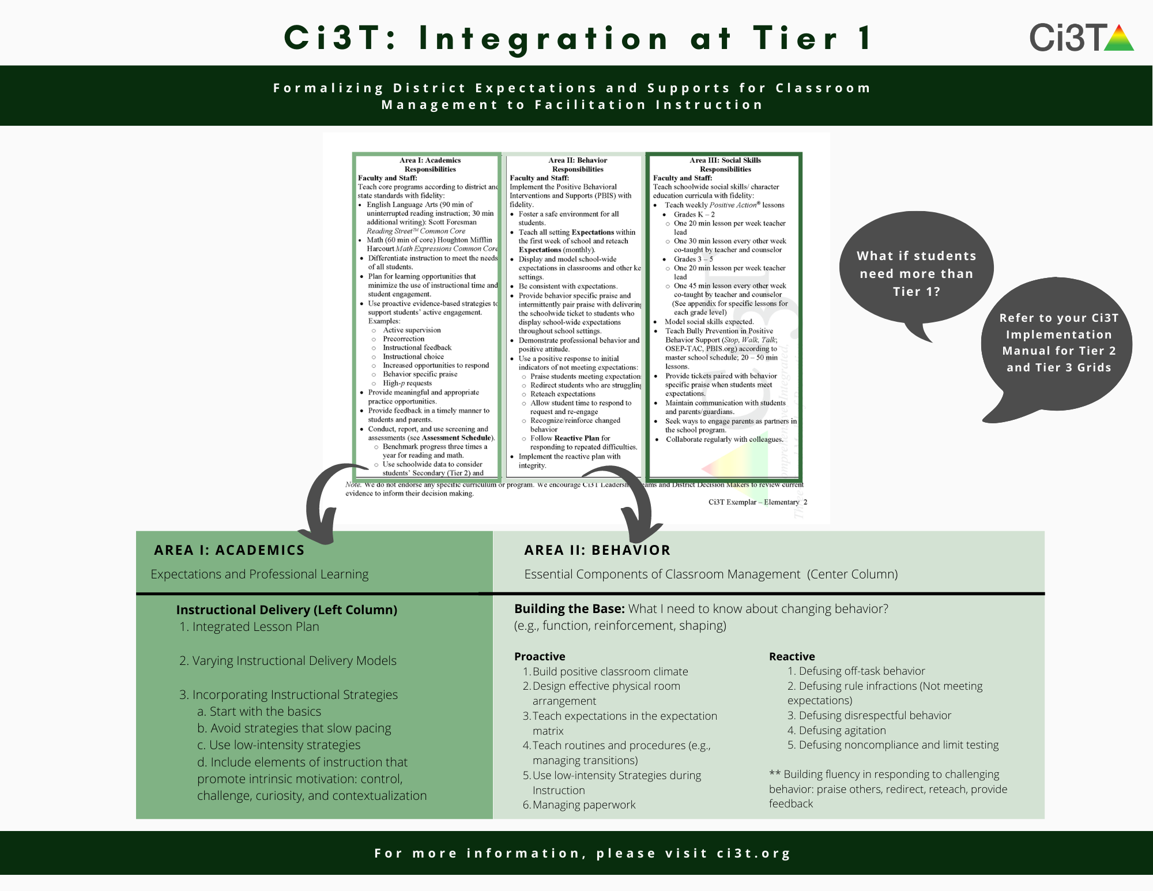

Slide 12

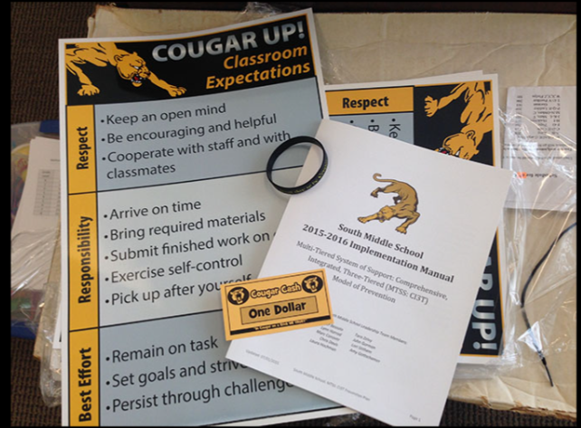
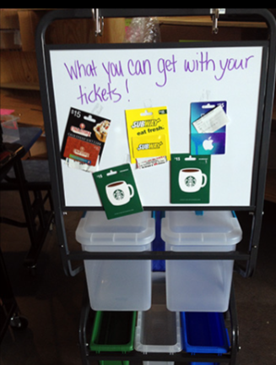
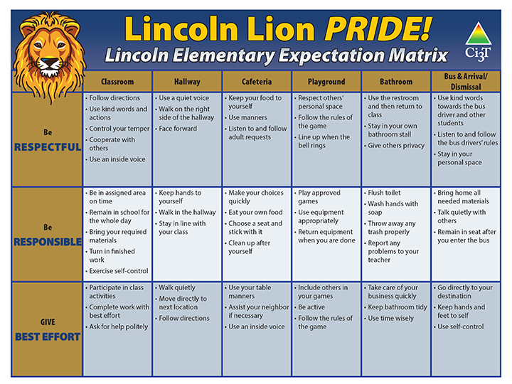
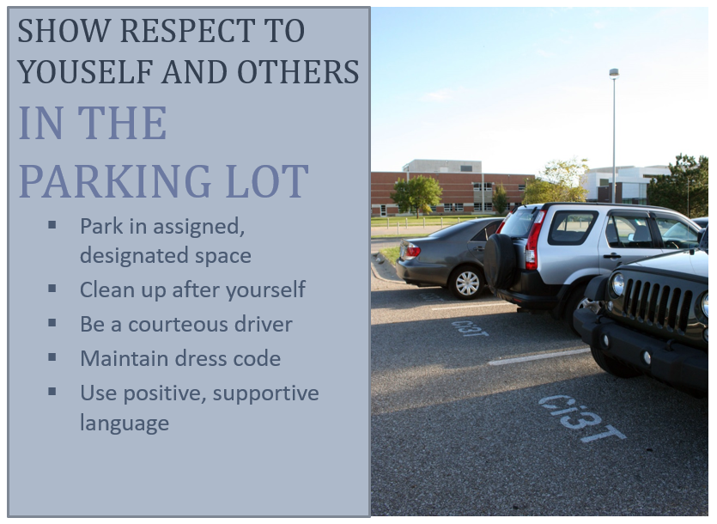
Area II: Academics Responsibilities Faculty and Staff: Teach core programs according to district and state standards with integrity: Use teacher-delivered, low-intensity strategies to support students’ active engagement | Area II: Behavior Responsibilities Faculty and Staff: Implement Positive Behavioral Interventions and Supports (PBIS) with integrity. Teach all setting Expectations within the first week of school and reteach Expectations (monthly). Display and model school-wide expectations in classrooms and other key settings. Provide behavior specific praise and intermittently pair praise with delivering the schoolwide ticket to students who display school-wide expectations throughout school settings. Implement the reactive plan with integrity. | Area II: Social Responsibilities Faculty and Staff: Teach schoolwide social skills/ character education curricula with integrity: Teach daily Second Step ® lessons (link to grade level instructional schedules) Seek ways to engage parents as partners in the school program

Slide 13

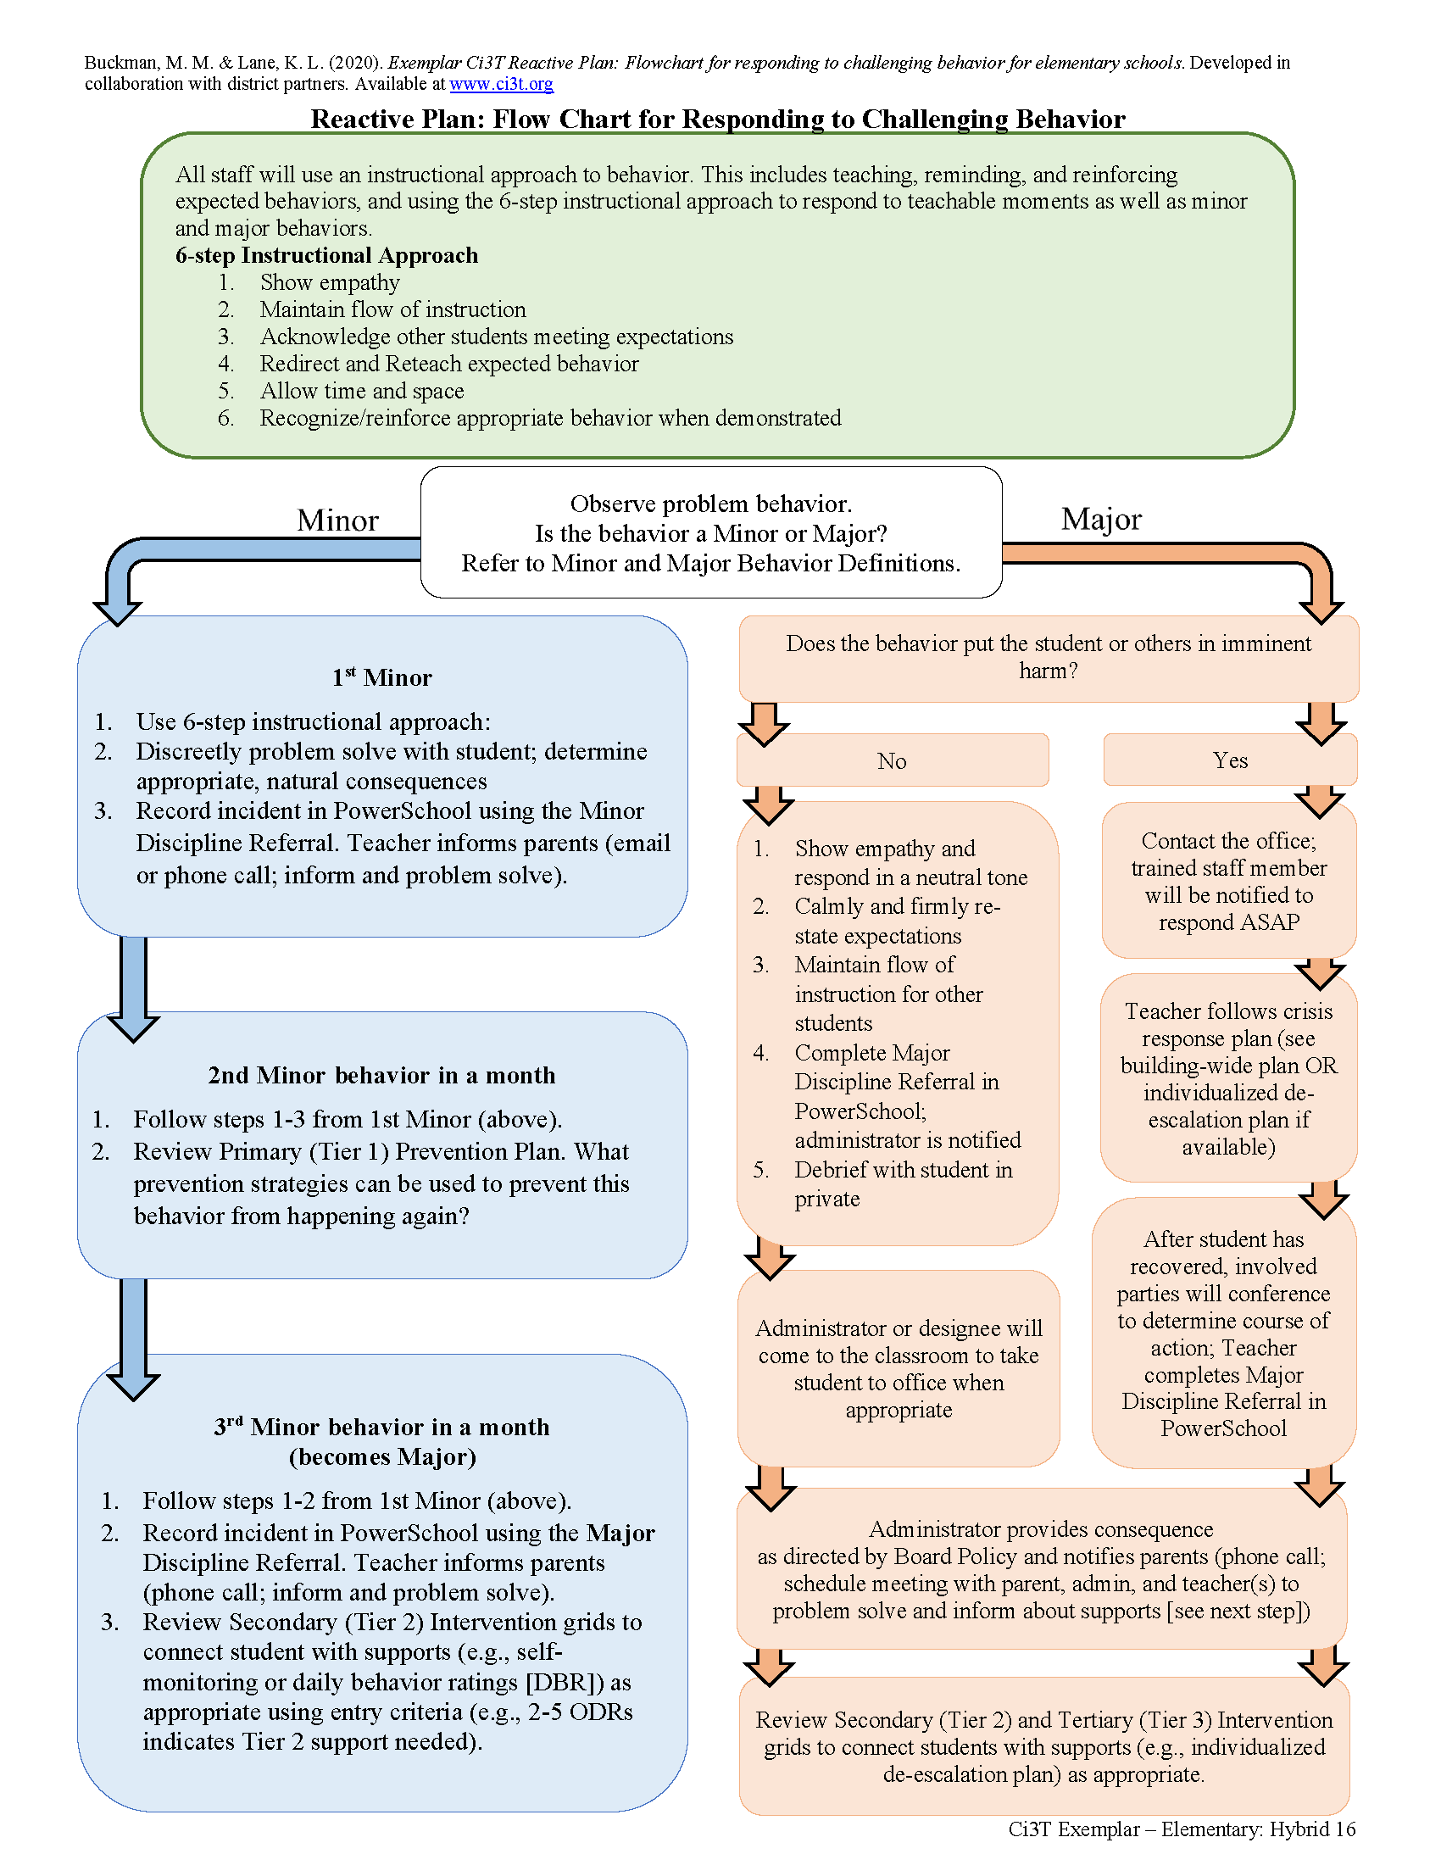
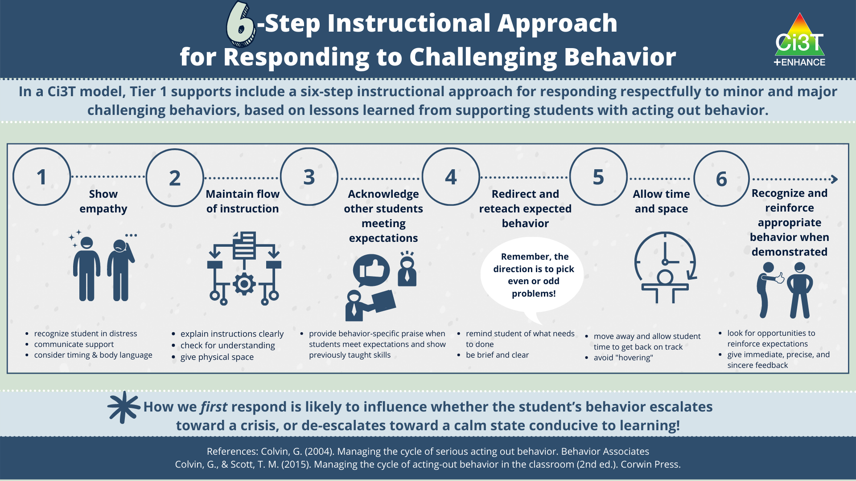

Slide 14
How are you currently responding to challenging behaviors during instruction?
Notes:
Interactions between students and teachers

Slide 15
6-Step Instructional Approach for Responding to Challenging Behavior

Slide 18

How Do I Implement a 6-Step Instructional Approach at My School?
Step 1
Show empathy
Step 2
Maintain the flow of instruction
Step 3
Acknowledge other students meeting expectations
Step 4
Redirect and reteach expected behavior
Step 5
Allow time and space
Step 6
Recognize and reinforce expected behavior when demonstrated

Slide 19

Step 1: Show empathy
What to do
Why to do it
What to avoid

Slide 20
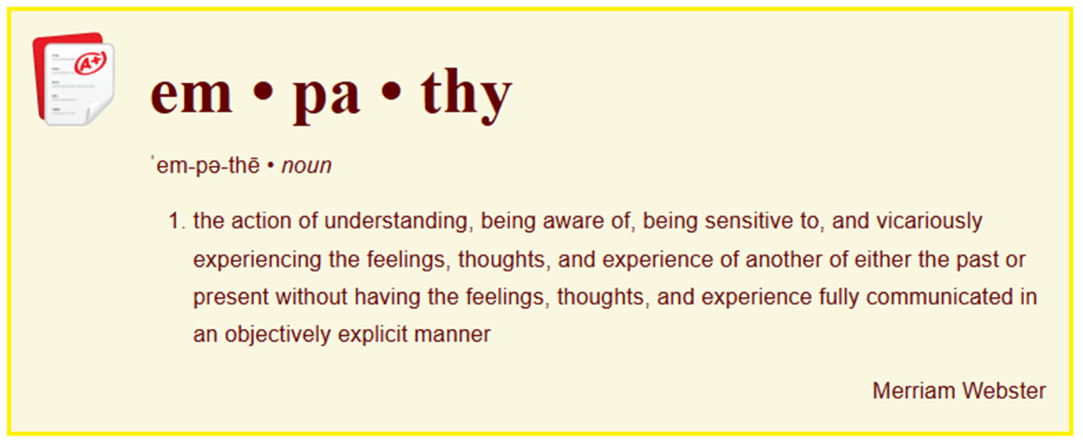
Step 1: Show empathy

Slide 21
Step 1: Show empathy
What to do
Connect privately
Strategically pause instruction
Body language
Verbally acknowledge & validate emotions
Why to do it
What to avoid

Slide 22
Step 1: Show empathy
What to do
Why to do it
Builds relationships
Less likely to lead to escalation
What to avoid

Slide 23
Step 1: Show empathy
What to do
Why to do it
What to avoid
Harsh & public communication
Overbearing
Long winded

Slide 24
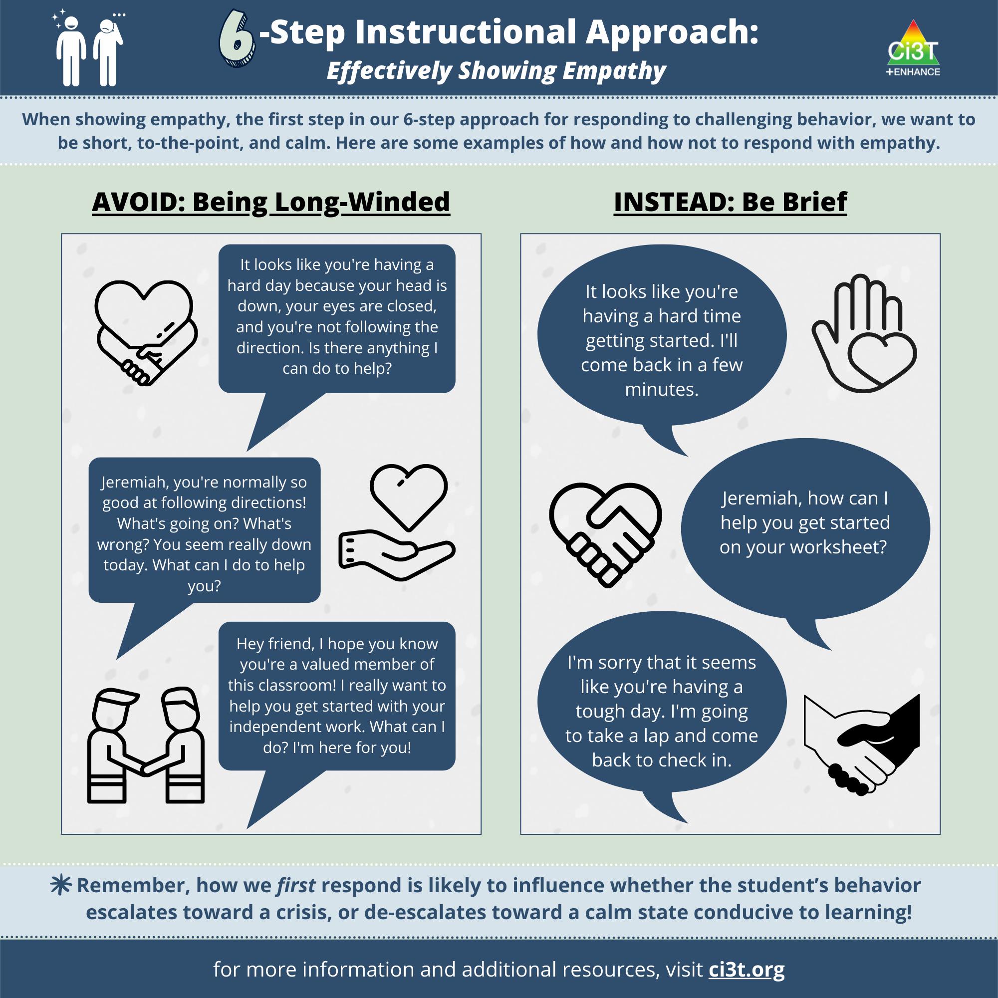

Slide 25

Illustration Background
Setting: 6th grade Science Classroom
Time: 8:30 a.m.
Date: October 25

Slide 26
Illustration
Mrs. Hill heads over to Paul’s desk. She sits in a chair next to him at the back of the room at the lab station. She makes sure to be respectful of Paul’s personal space. In a confidential manner, Mrs. Hill says, “Hey, Paul. I noticed you’re sitting away from the desks today. Is there something I can do to help you get started on the bellringer?” “No,” he mumbles into his crossed arms. “I don’t want to do this right now.”

Slide 27

Let’s Chat!
What could Mrs. Hill say to Paul?
Nothing, walk away.
You know the rules, move.
I understand. I’ll check back in a minute

Slide 28

Step 2: Maintain the flow of instruction
What to do
Repeat instructions in a positive, friendly tone
Physical movement
Why to do it
What to avoid

Slide 29
Step 2: Maintain the flow of instruction
What to do
Why to do it
Creates solutions-based environments
What to avoid

Slide 30
Step 2: Maintain the flow of instruction
What to do
Why to do it
What to avoid
Engaging in arguments
Providing too much attention

Slide 31
Illustration
Even though Mrs. Hill sees that Paul is still sitting in the lab station, she keeps instruction moving forward by moving on to check on other students who are getting started on their assignments. She uses active supervision by moving through the classroom, visually scanning the room to see who might need help, and providing positive verbal interactions to acknowledge students who are meeting expectations.

Slide 32








Let’s Talk!
Use your handout to develop a few statements you could use in the moment
www.ci3t.org/presentations
Notes:
5-min timer

Slide 33

Step 3: Acknowledge other students meeting expectations
What to do
Behavior-specific praise
Keep instruction moving forward
Be calm and sincere
Why to do it
What to avoid

Slide 34
Step 3: Acknowledge other students meeting expectations
What to do
Why to do it
Creates a positive, praise-rich environment to reinforce what is expected
What to avoid

Slide 35
Step 3: Acknowledge other students meeting expectations
What to do
Why to do it
What to avoid
Raising voice
Body language that communicates distress or frustration

Slide 36
Let’s Chat!
On her way back to Paul, Mrs. Hill notices some students doing an excellent job of solving their selected problems and starting to check their work with their shoulder partner.
What could Mrs. Hill say/do with other students?

Slide 37
Illustration
Mrs. Hill looks at Liza and Bree and tells them, “You both are doing a great job of explaining your answers.” She hands them a ticket.
Next, Mrs. Hill takes a calming breath, smiles at Paul who is looking her way, and walks over to the lab station. In her mind, she thinks to herself, “You’ve got this…”

Slide 38

Step 4: Redirect and reteach expected behavior
What to do
Redirect the student to the task
Provide reminders
Reteach expected behavior
Why to do it
What to avoid

Slide 39
Step 4: Redirect and reteach expected behavior
What to do
Why to do it
Gives the student a way to get back on track quickly and respectfully
What to avoid

Slide 40
Step 4: Redirect and reteach expected behavior
What to do
Why to do it
What to avoid
Long conversations

Slide 41
Illustration
Mrs. Hill smiles at Paul and makes eye contact. She says, “Paul, you did great with these problems yesterday. Remember, the digestive system diagram you will need is right here in the book [pointing to the box with the diagram].
The good news is you can pick any five questions you would like.” Mrs. Hill points to the answer sheet and says, “Which one would you like to start with?”

Slide 42
Let’s Talk!
Brainstorm ways to keep instruction moving in your classrooms! Turn & talk Preview & review Getting out materials
www.ci3t.org/presentations
Notes:
5-min timer

Slide 43

Step 5: Allow time and space
What to do
Offer choice to get back on track
Why to do it
What to avoid

Slide 44
Step 5: Allow time and space
What to do
Why to do it
Reduces perceived tension or pressure
What to avoid

Slide 45
Step 5: Allow time and space
What to do
Why to do it
What to avoid
Hovering

Slide 46
Illustration
After suggesting to Paul, he begin either #1 or #5 to, Mrs. Hill steps away and checks on Ben, a student seated close to the lab station.
She smiles at Ben, nodding at the progress he has made thus far and says, “Great progress, Ben. Looks like you are just about ready to talk through your answers with Paul.”

Slide 47
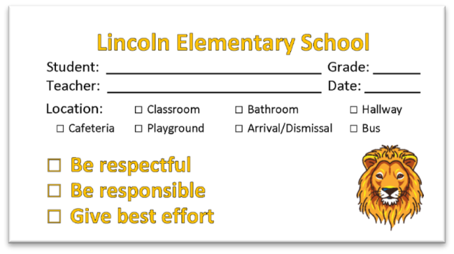
Step 6: Recognize and reinforce expected behavior when demonstrated
What to do
Provide the student with
a reinforcer
Lincoln High School
_Gym
_Classroom
_Cafeteria
_Bathroom
_Arrival/Dismissal
_Hallway
_Bus/Parking Lot
Why to do it
What to avoid

Slide 48
Step 6: Recognize and reinforce expected behavior when demonstrated
What to do
Why to do it
Lincoln High School
_Gym
_Classroom
_Cafeteria
_Bathroom
_Arrival/Dismissal
_Hallway
_Bus/Parking Lot
Performance feedback
What to avoid

Slide 49
Step 6: Recognize and reinforce expected behavior when demonstrated
What to do
Why to do it
Lincoln High School
What to avoid
_Gym
_Classroom
_Cafeteria
_Bathroom
_Arrival/Dismissal
_Hallway
_Bus/Parking Lot
Being too enthusiastic

Slide 50
Illustration
Out of the corner of her eye, Mrs. Hill notices Paul has moved to sitting in a desk next to Ben and completed #5. Mrs. Hill says, “Terrific, Paul. I appreciate you getting started. Thank you for sitting with Ben to talk through your answers.”
She hands both Paul and Ben a ticket. Paul somewhat reluctantly takes the ticket from Mrs. Hill’s hand and smirks a half-smile. “Thanks, Mrs. Hill. Are you ready, Ben?” says Paul.

Slide 52
Continuing the Conversation
If this occurred in your classroom/school, what might happen differently? What are some pitfalls and challenges you could see coming out of this situation? | What are some potential ways to address these challenges? Who is someone you could ask in your building or district to troubleshoot a more complex or challenging circumstance, should one arise?
Notes:
5-min

Slide 53


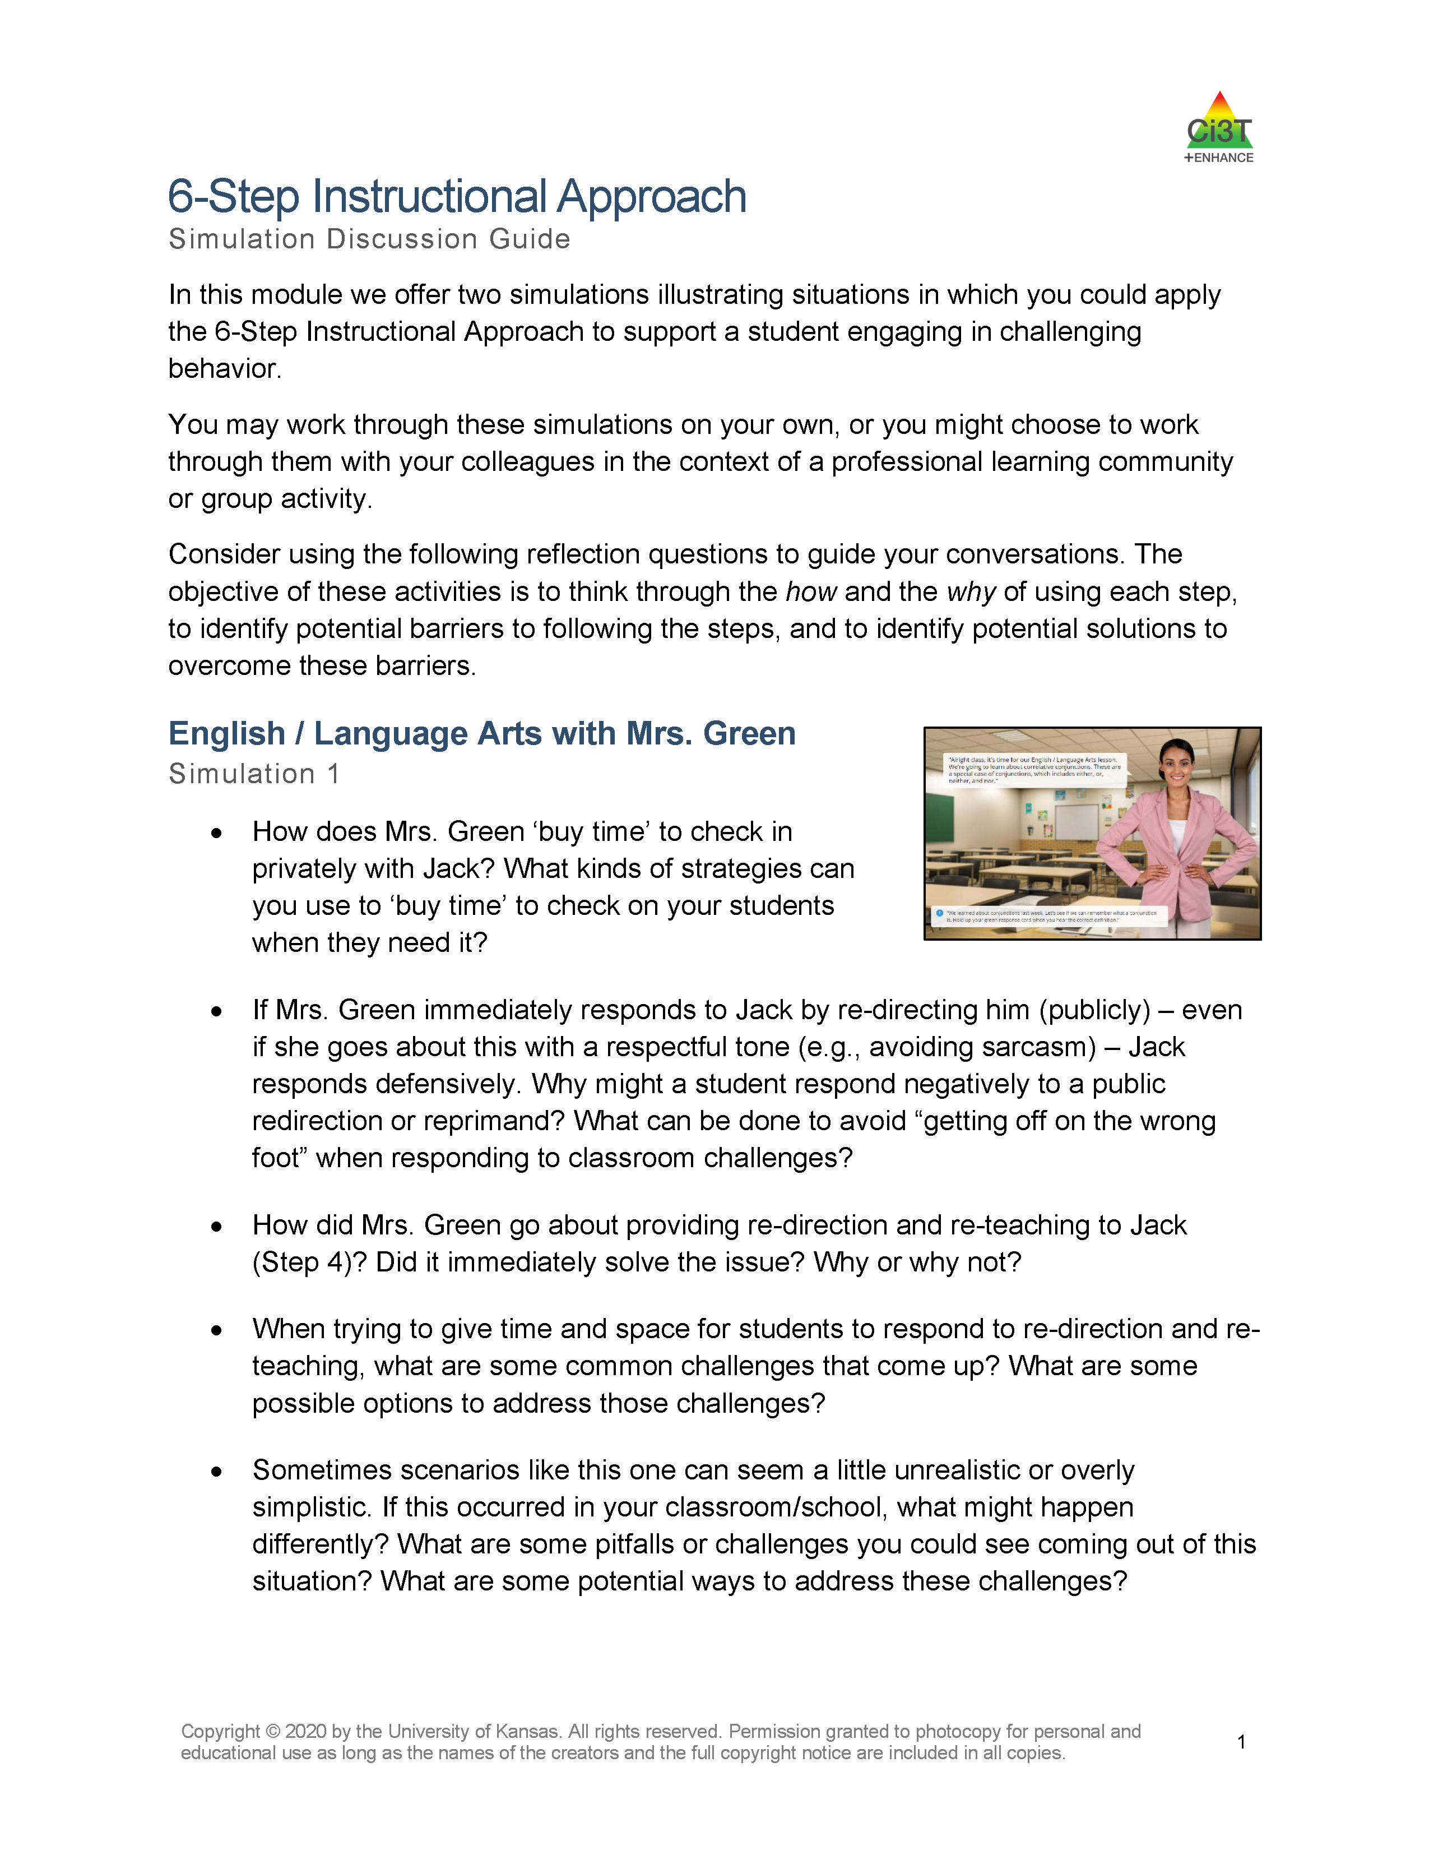
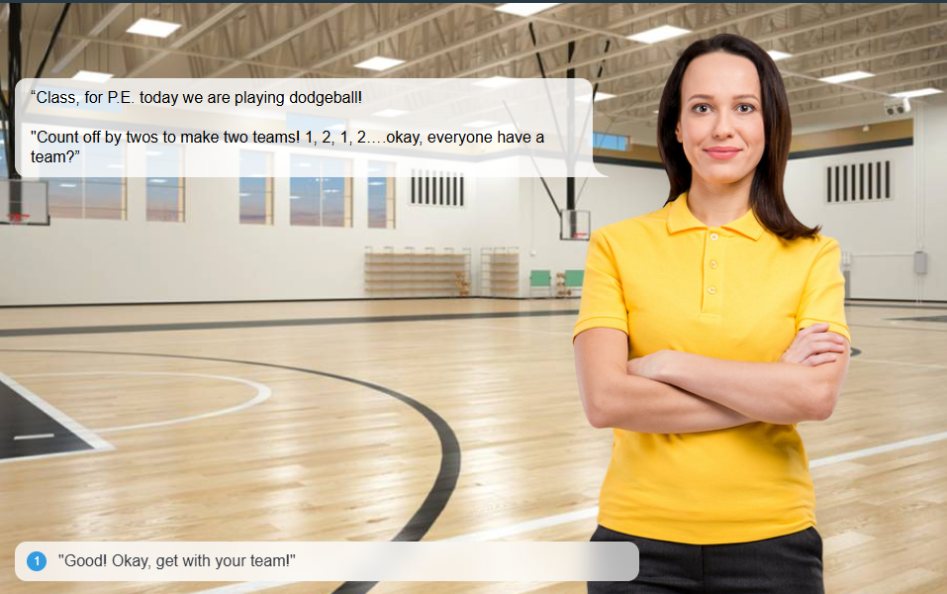
Additional Practice
Notes:
Log into module: https://kusurvey.ca1.qualtrics.com/jfe/form/SV_06S3oTg2Ez7bsFg
Model:
Sign In
Using table of contents to navigate to simulation and discussion guide

Slide 54
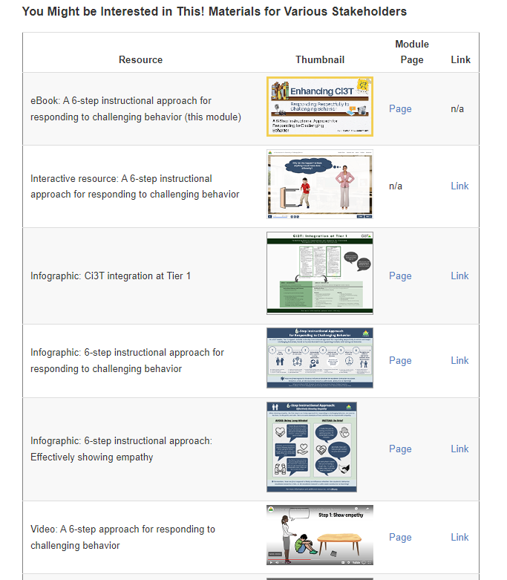
Resources

Slide 55
Connecting Students to More Intensive Interventions

Slide 57

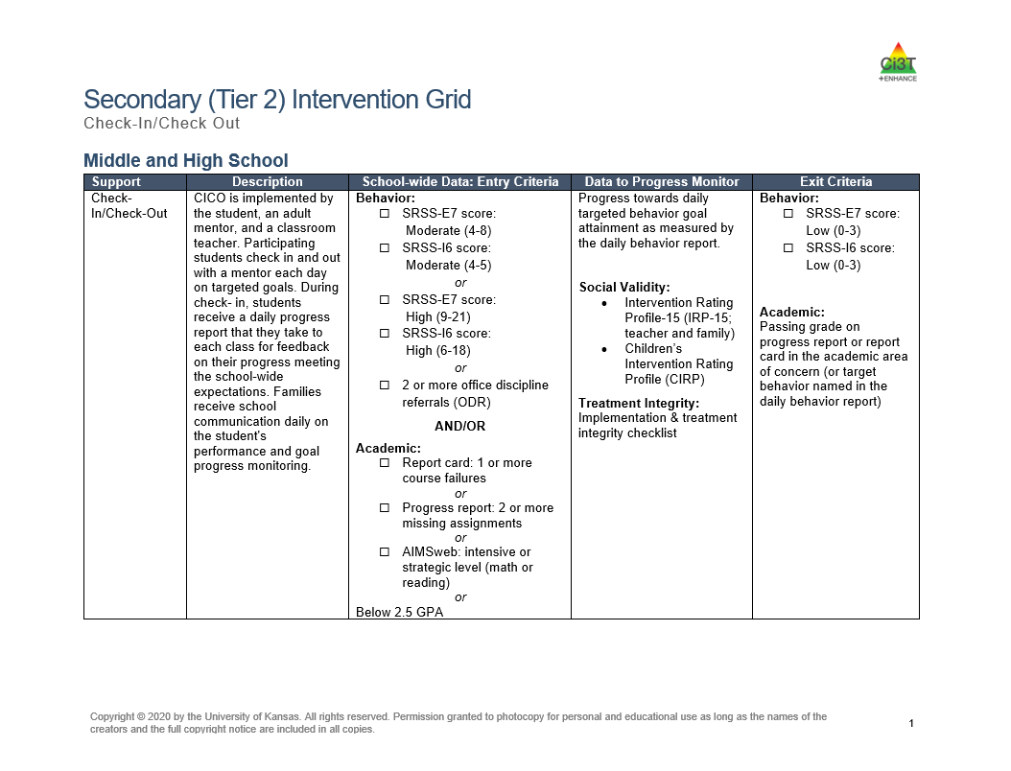
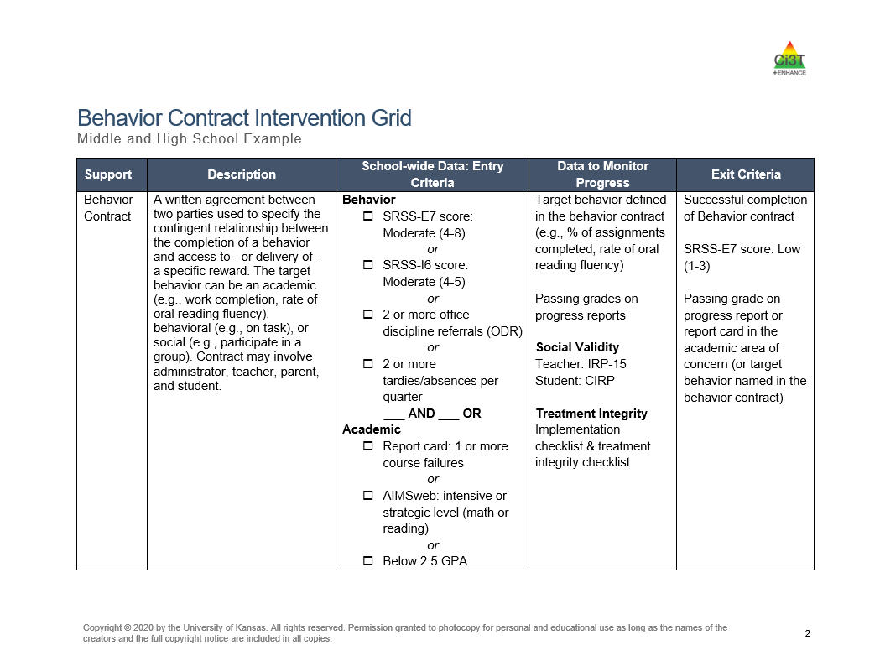


Tier 2 Supports
Notes:
Tier 1 is not always going to be enough. Tier 2 supports such as behavior contracts or social skills might be needed. The Secondary (Tier 2) Intervention Grids in your Ci3T Implementation Manual highlight the Tier 2 interventions offered at your school. Use the grids alongside screening data to connect students with Tier 2 intervention.

Slide 58







Tier 3 Supports
Notes:
For students with exceptionally challenging behaviors, Tier 3 supports such as an individualized de-escalation plan may be needed.

Slide 59
Wrapping Up and Moving Forward

Slide 60
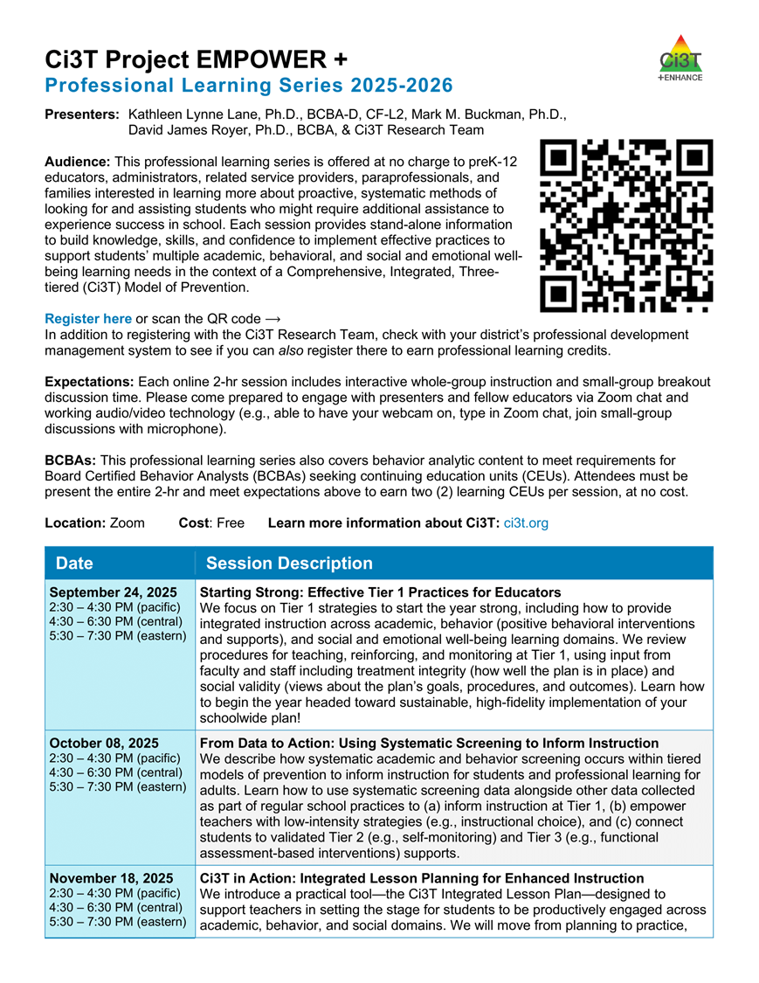
Project EMPOWER+
EMPOWER+ Session | Date
Starting Strong: Effective Tier 1 Practices for Educators | September 24, 2025 (Wednesday)
From Data to Action: Using Systematic Screening to Inform Instruction | October 8, 2025 (Wednesday)
Ci3T In Action: Integrated Lesson Planning for Enhanced Instruction | November 18, 2025 (Tuesday)
Mastering Behavior Specific Praise and Precorrection | January 21, 2026 (Wednesday)
A 6-Step Instructional Approach for Responding to Challenging Behaviors: A Tier 1 Practice | February 10, 2026 (Tuesday)
A Tier 2 Support for Students Experiencing Anxious Feelings: Recognize. Relax. Record. | March 25, 2026 (Wednesday)
A Tier 3 Support for Students with Intensive Intervention Needs: Functional Assessment-Based Intervention (FABI) | April 28, 2026 (Tuesday)

Slide 61
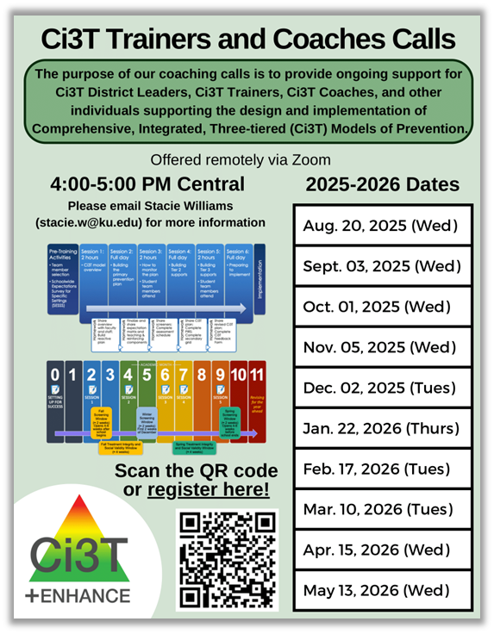
Ci3T Trainers and Coaches Calls
Ci3T Trainers and Coaches Calls Session | Date
Ci3T Trainers and Coaches Call 1 | August 20, 2025 (Wednesday)
Ci3T Trainers and Coaches Call 2 | September 3, 2025 (Wednesday)
Ci3T Trainers and Coaches Call 3 | October 1, 2025 (Wednesday)
Ci3T Trainers and Coaches Call 4 | November 5, 2025 (Wednesday)
Ci3T Trainers and Coaches Call 5 | December 2, 2025 (Tuesday)
Ci3T Trainers and Coaches Call 6 | January 22, 2026 (Thursday)
Ci3T Trainers and Coaches Call 7 | February 17, 2026 (Tuesday)
Ci3T Trainers and Coaches Call 8 | March 10, 2026 (Tuesday)
Ci3T Trainers and Coaches Call 9 | April 15, 2026 (Wednesday)
Ci3T Trainers and Coaches Call 10 | May 13, 2026 (Wednesday)

Slide 62

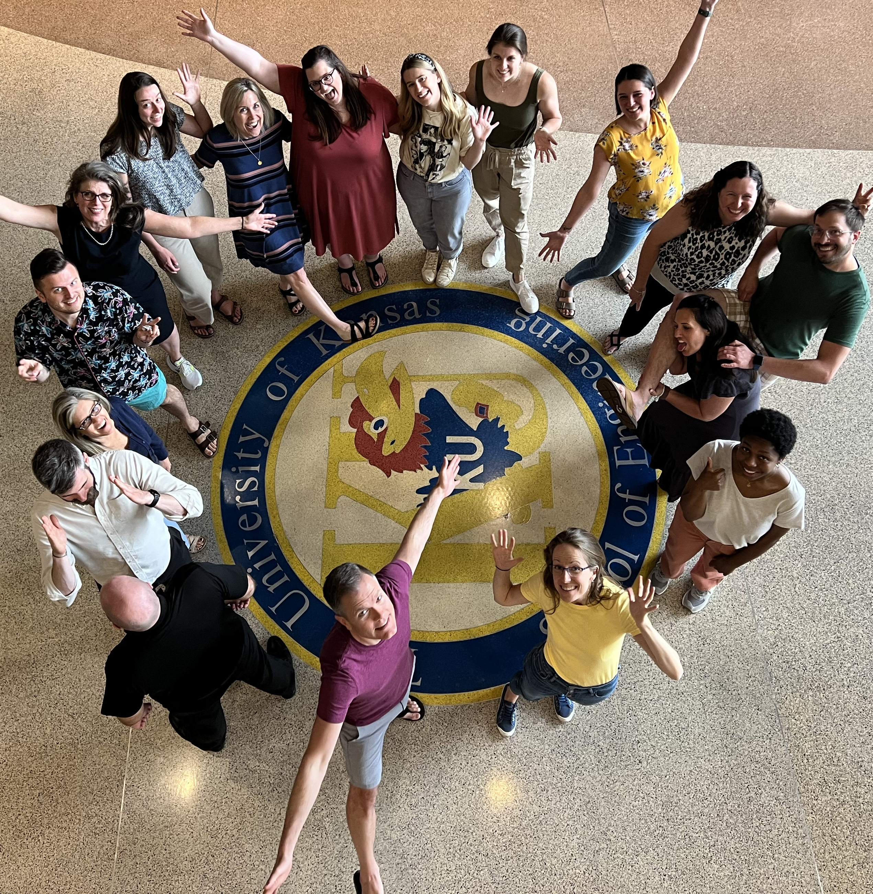

Thank you!
Thank you!
ci3t.org
#Ci3T
@Ci3Tmodel
Tag us in your Ci3T highlights, we love to see Ci3T in action!
Follow us on Instagram for updates and new resources!
Notes:
Tag us in your Ci3T highlights- we would love to see Ci3T in action! Follow us on Instagram for updates and links to resources! @Ci3TModel
You will receive a brief session evaluation – we value your feedback and would greatly appreciate you taking a few minutes to share your thoughts on what you liked about the session and how we can improve

